Slide 1
Data Center Permissions

Slide 2
Problem
Assign users to the correct data permission on registration
Ensure only appropriate users gain access to data

Slide 3
Possible Solutions
Manual Drupal permission
Approval Queue
Automated Approval

Slide 4
Assessment
Option | Detail | Level Of Effort | Pros | Cons
Manual Drupal permission | - User registers, and is put in data center lite. - At the end of the day, I generate a report of new users for Suzette - Suzette reviews the list, and for each user that she wants to approve, she goes to nyseconnect.com/user/<userid>, and checks the “data center full” permission. | 0 days | Done already | All users need to be reviewed Difficult to use Delay between registration and full access
Approval Queue | - user registers, and is entered into an approval queue – throughout the day, Suzette reviews the queue, and approves appropriate users | 1 day | Easier to use | All users need to be reviewed delay between registration and access to full data
Automated Approval | - user registers, and in most cases is automatically approved - Other cases are added to an approval queue - throughout the day, Suzette reviews this smaller queue, and approves appropriate users | 3 days | no delay for most users between registration and access fixes email verification cleans up registration form Light approval workload More secure than human approval | Slightly higher development effort

Slide 5
Recommendation
Automated approval
  Best solution if cost is no issue, but cost is low anyway
  More secure than other options due to email verification – we know you are who you say you are

Slide 6
Appendix
Documentation for
Automated Approval

Slide 7
Criteria to access data
Must be a member of a publicly traded company
Must be either manually approved, or present an email address and symbol that matches a record in SalesLogix with job codes specified by Services team, including
  IRO
  CFO
Must verify their email address

Slide 8
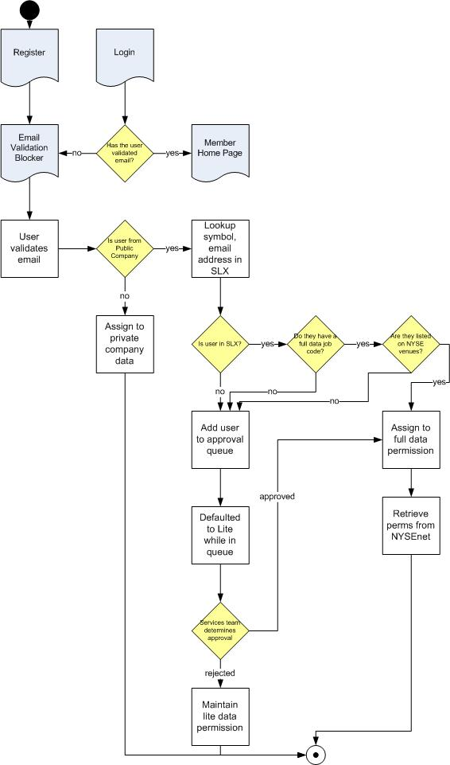
Workflow

Slide 9
Example Workflow Paths
Private Company
System detects that the user is not part of a publicly traded company, assigns them data for S&P 500, and data center lite. Not entered in approval queue. Must validate email solely for notifications.
Public company, low level employee
System detects that the user is part of a publicly traded company on registration.
System looks up symbol, email address in SLX, does not find a match, or finds a match that does not have the correct job code
User is entered into approval queue, since we cannot confirm their job level, and is defaulted to lite date until the services team makes a decision
Services team grants the correct permission based on their review of the user's profile
Public company, financials employee
System detects that the user is part of a publicly traded company on registration.
System looks up symbol, email address in SLX, does not find a match
  User is entered into approval queue, since we cannot validate their job level, and is defaulted to lite date until the services team makes a decision
  Services team reviews the profile and grants full data permission
System looks up symbol email address in SLX, finds a match, and the user has a matching job code for full data
  System assigns them to full data state
Public company, not NYSE
System detects that the user is part of a publicly traded company on registration.
System looks up symbol, email address in SLX, finds a match
System looks up symbol, finds that it is not a symbol listed here
  User is entered into approval queue, since we cannot validate their job level, and is defaulted to lite date until the services team makes a decision
  Services team reviews the profile and grants the appropriate data permission
All users:
If the user is granted full data permission, the system will query NYSEnet with their email address, and if a record is found, their permissions for Thomson, LiquidNet and MAC Alerts will be transfered to Connect.

Slide 10
User States
Temporary States
  awaiting email validation
  pending approval
Final States
  full data
  lite data
  private company data (S&P 500)

Slide 11
Development Tasks
Job code lookup in SLX
Manual Approval Queue for Suzette/Theresa
Fix email verification
Removal of "Fill in Form" area on registration.

Slide 12
Full vs. Lite Data
Full
Real time quote
Detailed Quote
Price Chart
Corporate Actions
Broker Share
Trading Venues
Block Trades
Clearing Members
Intraday short volume
Historical short volume
Short interest report
Order Book
Lite
Real time quote
Detailed Quote
Price Chart
Corporate Actions

